Slide 1
Dijkstra’s Algorithm
CLRS Chapter 24.,

Slide 2
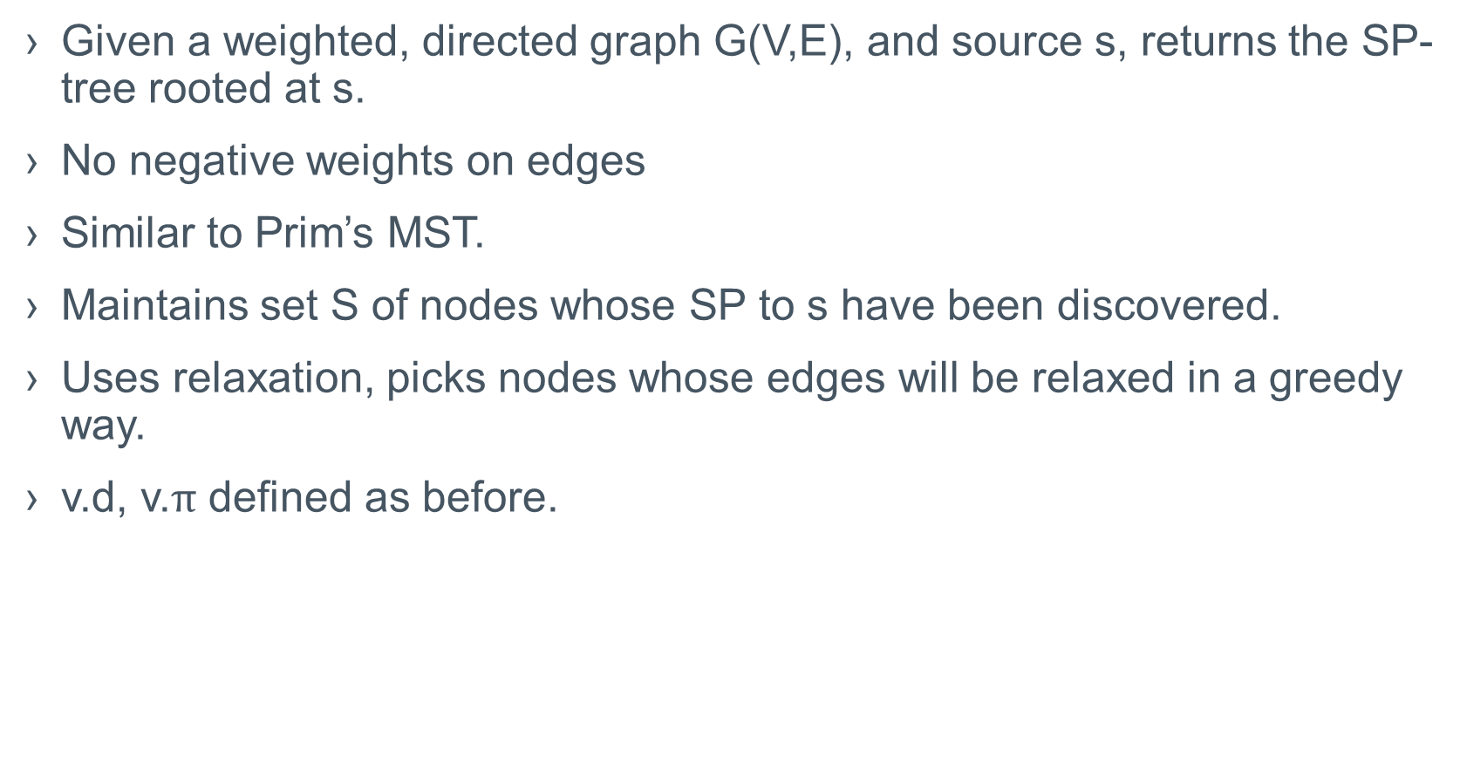
Dijkstra’a SSSP Algorithm
Given a weighted, directed graph G(V,E), and source s, returns the SP-tree rooted at s.
No negative weights on edges
Similar to Prim’s MST.
Maintains set S of nodes whose SP to s have been discovered.
Uses relaxation, picks nodes whose edges will be relaxed in a greedy way.
v.d, v.$π$ defined as before.

Slide 3
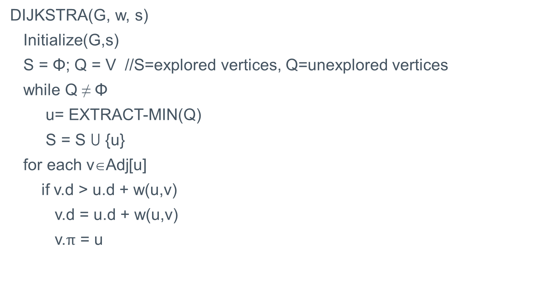
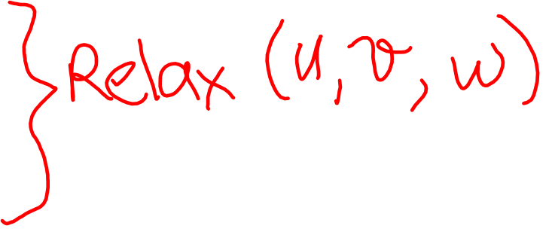
Dijkstra’s SSSP Algorithm
DIJKSTRA(G, w, s)
Initialize(G,s)
S = Φ; Q = V //S=explored vertices, Q=unexplored vertices
while Q ≠ Φ
u= EXTRACT-MIN(Q)
S = S U {u}
for each v∈Adj[u]
if v.d > u.d + w(u,v)
v.d = u.d + w(u,v)
v.$π$ = u

Slide 4
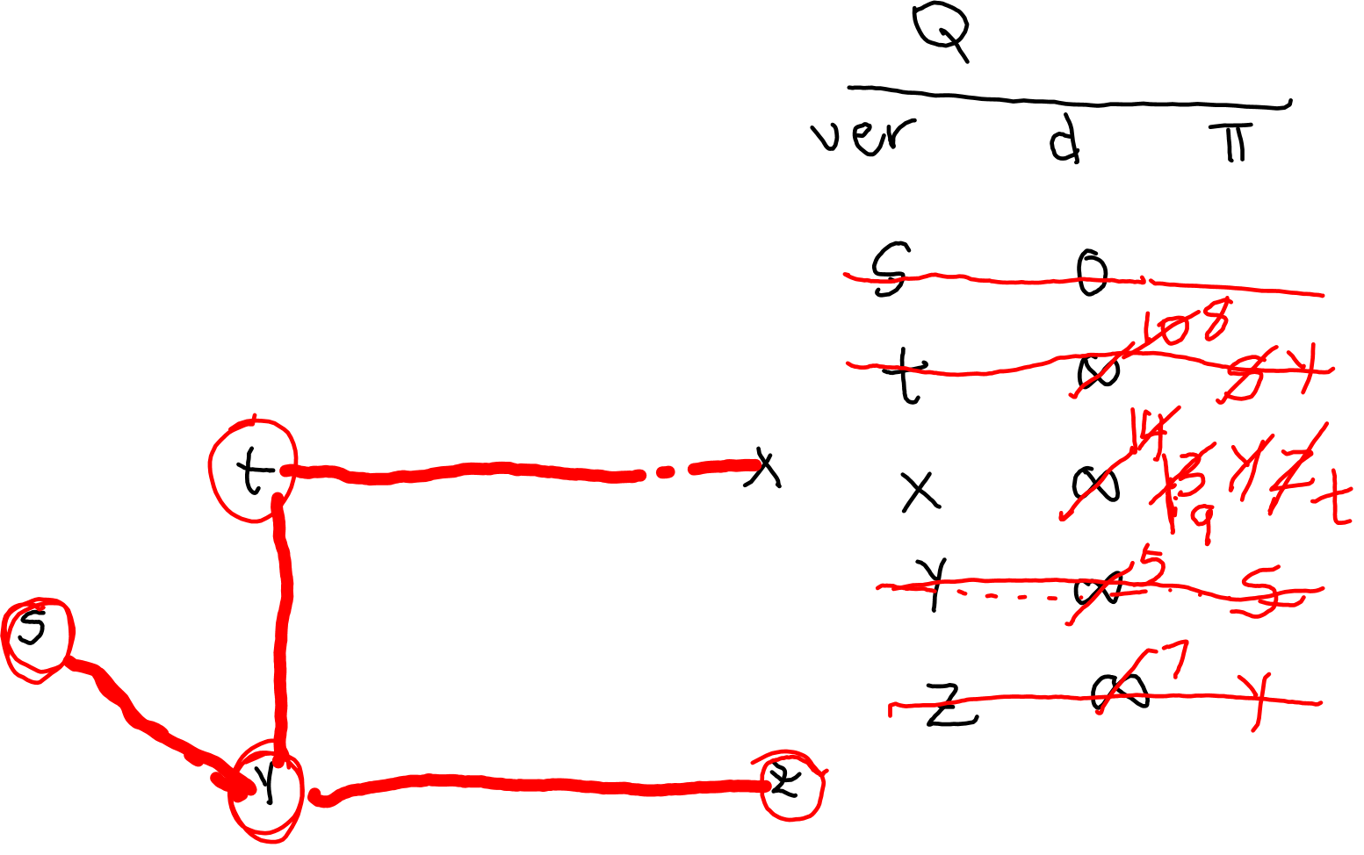
Dijsktra Example
1
10
2
3
9
4
6
7
5
2

Slide 5
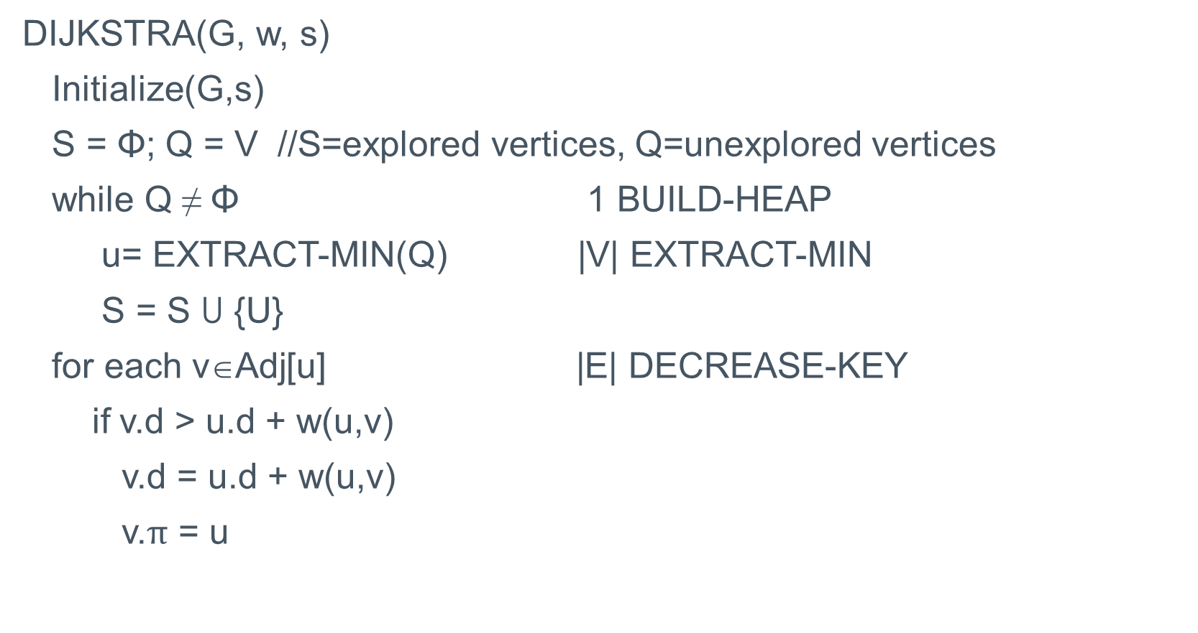
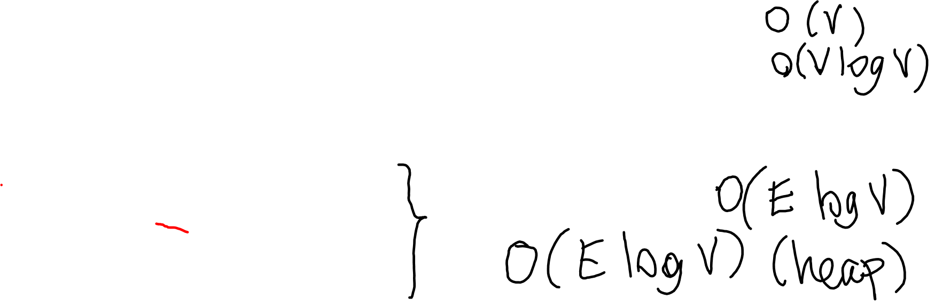
Dijkstra’s Running Time (min-heap)
DIJKSTRA(G, w, s)
Initialize(G,s)
S = Φ; Q = V //S=explored vertices, Q=unexplored vertices
while Q ≠ Φ 1 BUILD-HEAP
u= EXTRACT-MIN(Q) |V| EXTRACT-MIN
S = S U {U}
for each v∈Adj[u] |E| DECREASE-KEY
if v.d > u.d + w(u,v)
v.d = u.d + w(u,v)
v.$π$ = u

Slide 6
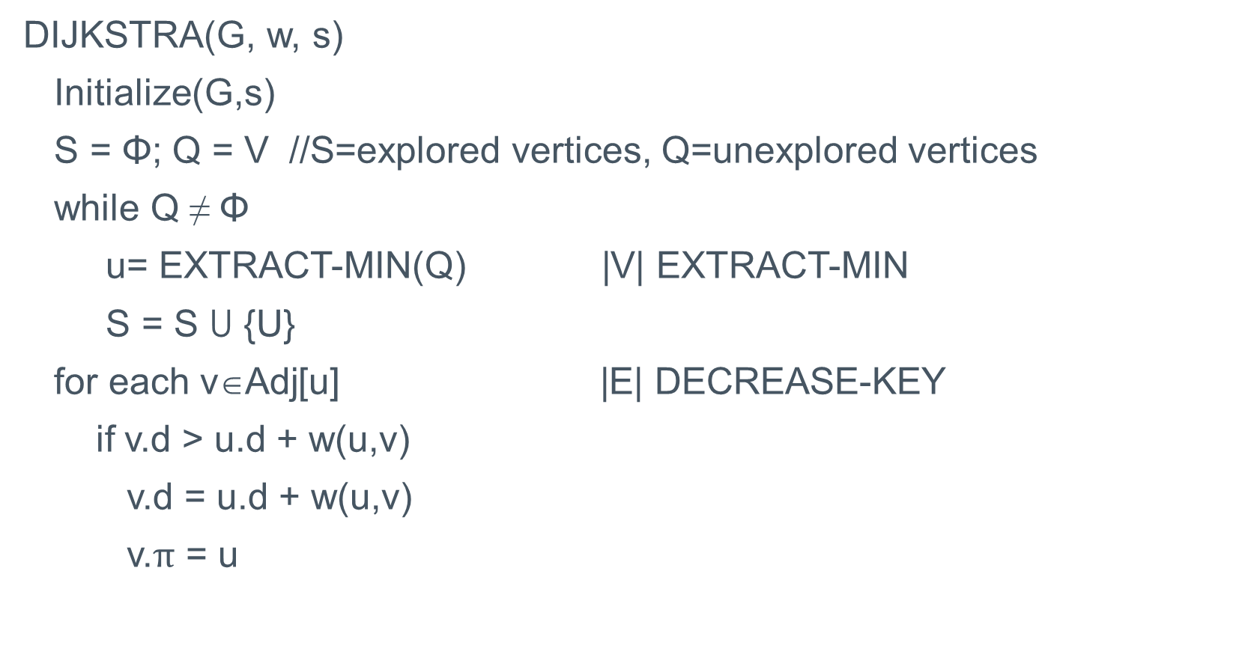
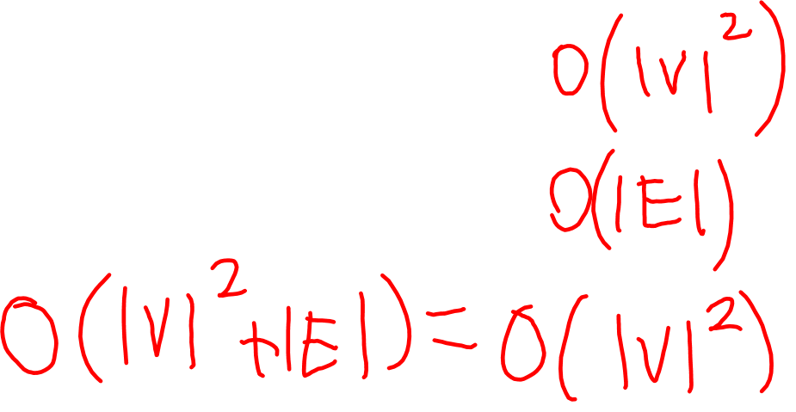
Dijkstra’s Running Time (array)
DIJKSTRA(G, w, s)
Initialize(G,s)
S = Φ; Q = V //S=explored vertices, Q=unexplored vertices
while Q ≠ Φ
u= EXTRACT-MIN(Q) |V| EXTRACT-MIN
S = S U {U}
for each v∈Adj[u] |E| DECREASE-KEY
if v.d > u.d + w(u,v)
v.d = u.d + w(u,v)
v.$π$ = u

Slide 7
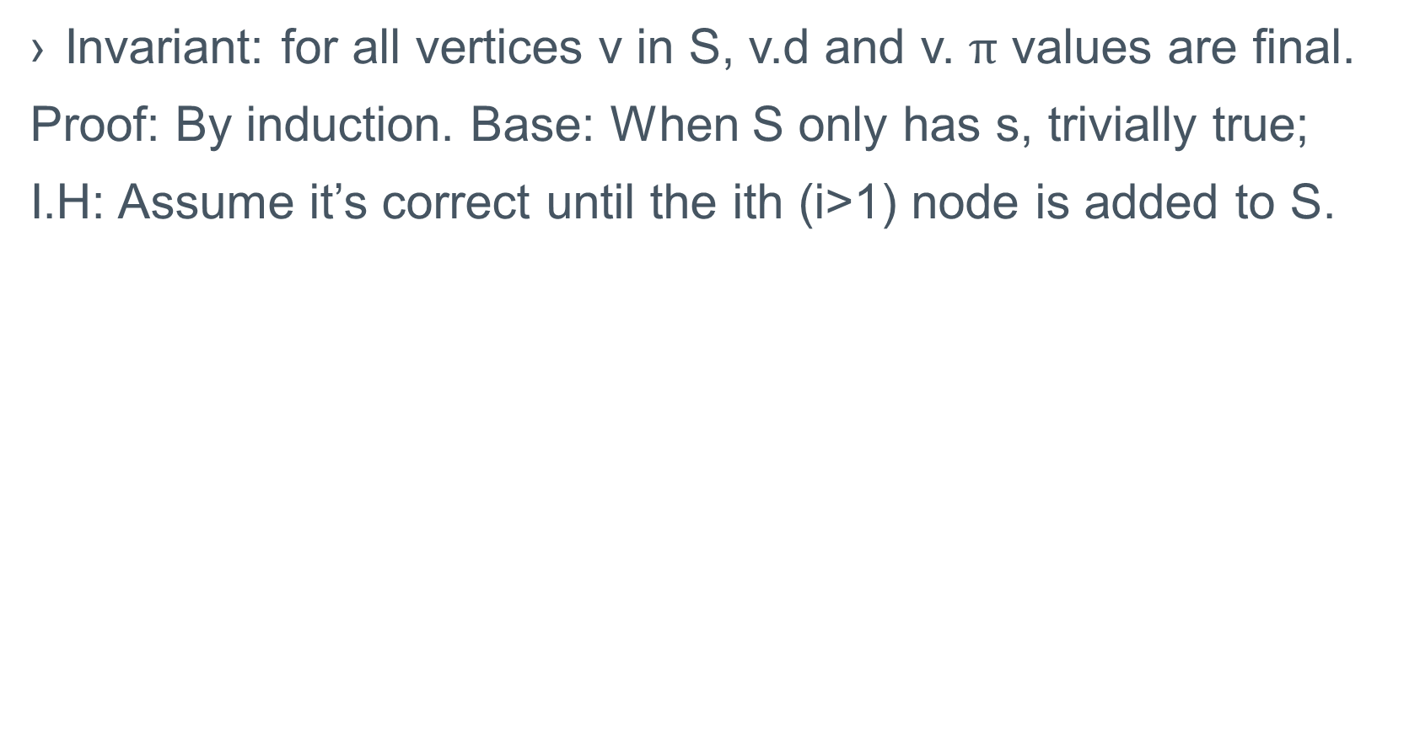
Correctness of Dijkstra
Invariant: for all vertices v in S, v.d and v. $π$ values are final.
Proof: By induction. Base: When S only has s, trivially true;
I.H: Assume it’s correct until the ith (i>1) node is added to S.

Slide 8
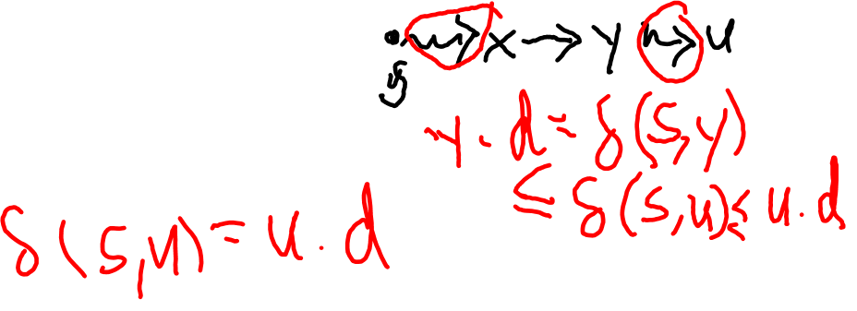
Correctness of Dijkstra, Continued
I.S: ith node added must have optimal d. Assume not, consider the first node u, that has nonoptimal d as it is added to S.
Consider p, shortest path from s to u, and consider its elements right before u gets added to S. Consider the first vertex y in p that is also in Q, and its predecessor, x in S. p=s..x→y..u. The path up to x is optimal by I.H. as x got placed in S, (x,y) got explored and y.d became optimal.
We must then have that y.d≤u.d.
But we also have u.d≤y.d as Extract-min returned u.
Thus u.d=y.d
Contradiction: u.d is optimal.

